Slide 1

Training Workshop
Introduction to Geospatial Raster and Vector Data with Python
Join us to learn how to use modern tools from the Python ecosystem to perform geospatial data analysis tasks:
pystac for EO data query and retrieval
rioxarray for raster data processing
geopandas for vector data processing
dask for distributed EO data processing
12-13 March ITC Building, Room 2301

Slide 2
Introduction to geospatial raster and vector data with python
CENTER OF EXPERTISE IN BIG GEODATA SCIENCE (CRIB)
Instructors: Adhitya Bhawiyuga , Jay Gohil
Helpers: Annisa Puspa Kirana, Jay Pandya, Likitpanjamanon PItchaporn

Slide 3
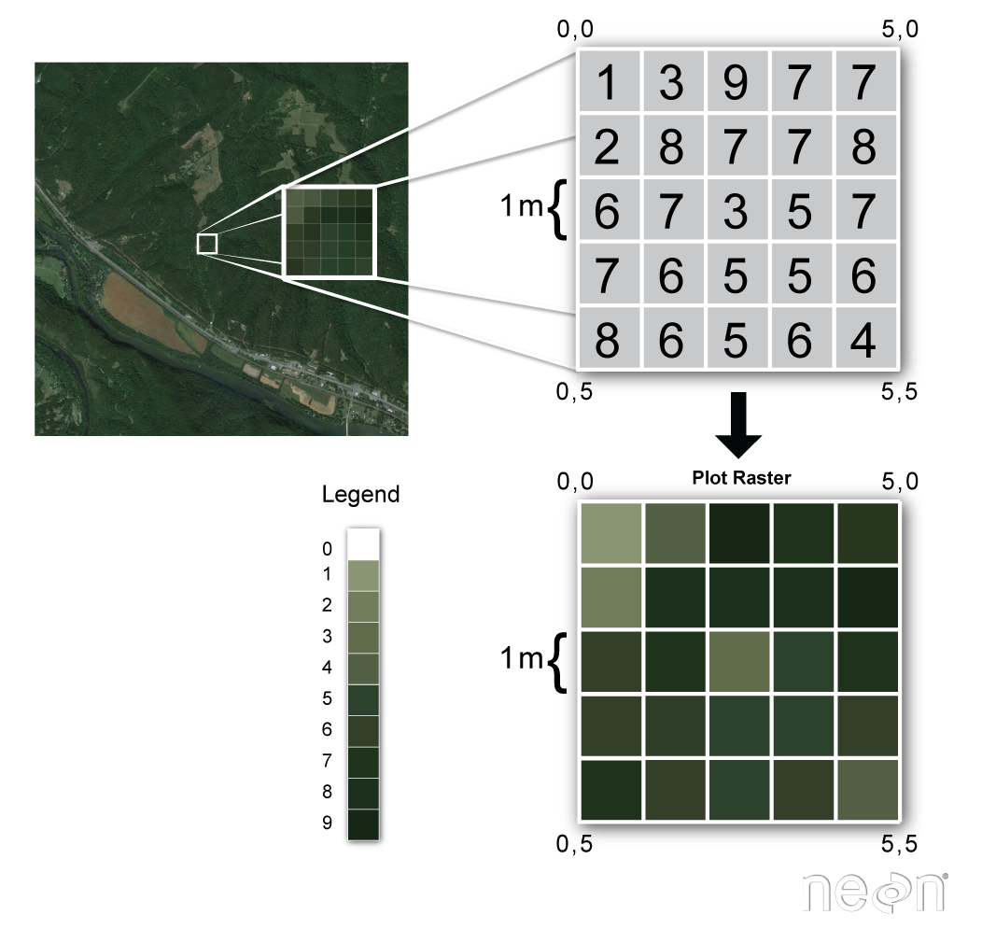
Raster data
Gridded data where each cell (pixel) value represents a real-world phenomena for instance land cover type, rainfall, temperature, elevation.
Sources include imagery from satellite, digital aerial photographs, digital pictures, scanned maps or derived from other point data by interpolation etc.
Geospatial attributes
Extent
Resolution
Projection
Notes:
Extent: Represents the overall geographic coverage of the spatial object. It could be line, point or polygon
Resolution: Represents the area on the ground that each pixel of the raster covers

Slide 4
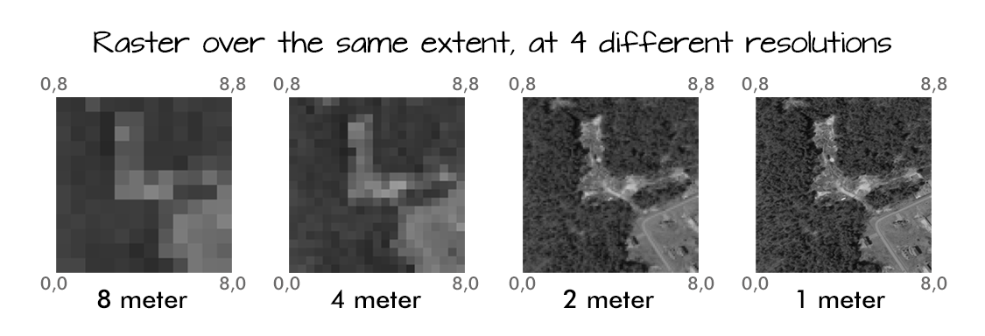
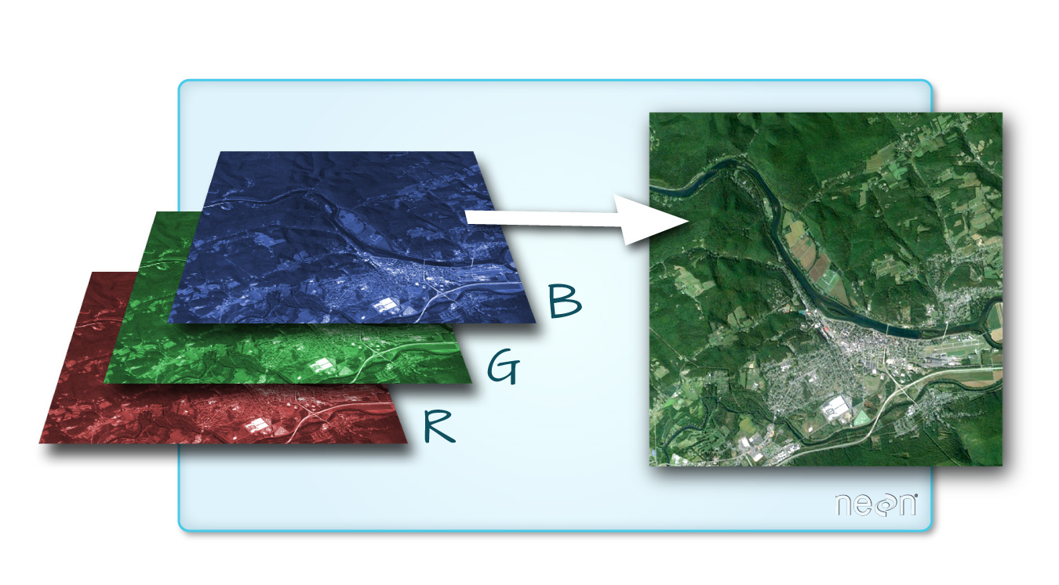
Raster data
Multi-band raster
Stack of layers having the same extent, resolution and CRS
Colored image: Red, Green, and Blue

Slide 5
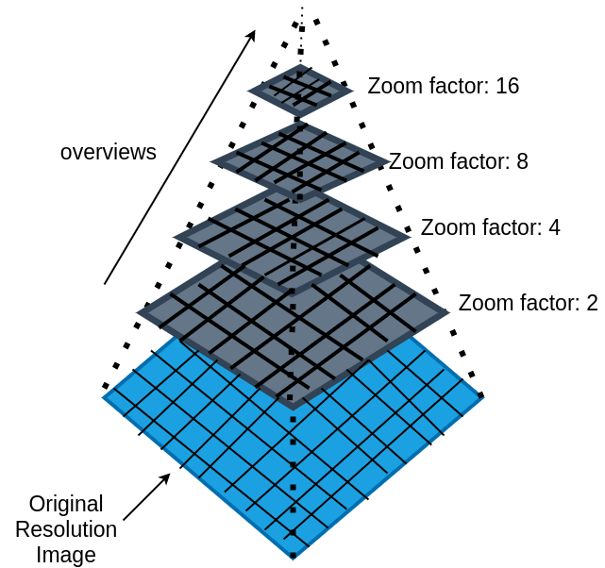
Cloud-Optimized GeoTIFF
Geotiff: standard TIF format with additional metadata (extent, resolution, CRS, nodata)
Tiling
Divide image to tiles (e.g., 256x256 or 512x512 pixels)
Access specific regions of the image
Overview
Multiple lower-resolution of original image
Compression and access data through HTTP

Slide 6
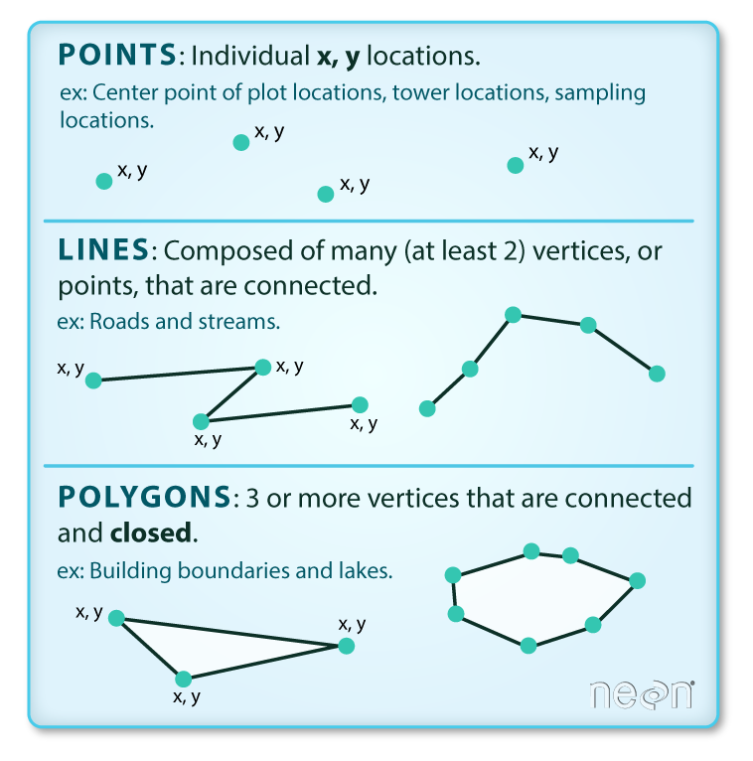
Vector data
Vector objects are used to represent geographic features by their shape/geometry, location and attributes.
Vector can either be:
Points
Lines
Polygons

Slide 7
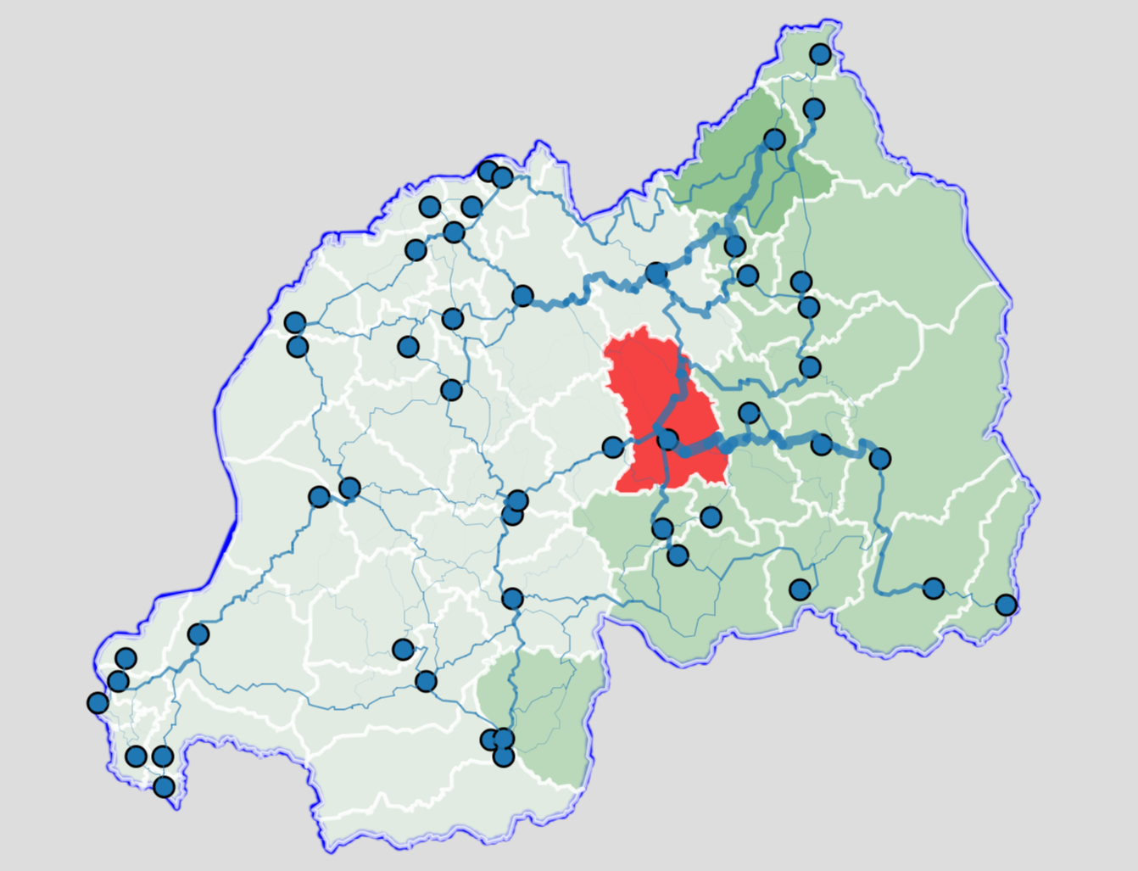
Vector data
Which vector types are represented in this map?
Market
Market catchment
Road network

Slide 8
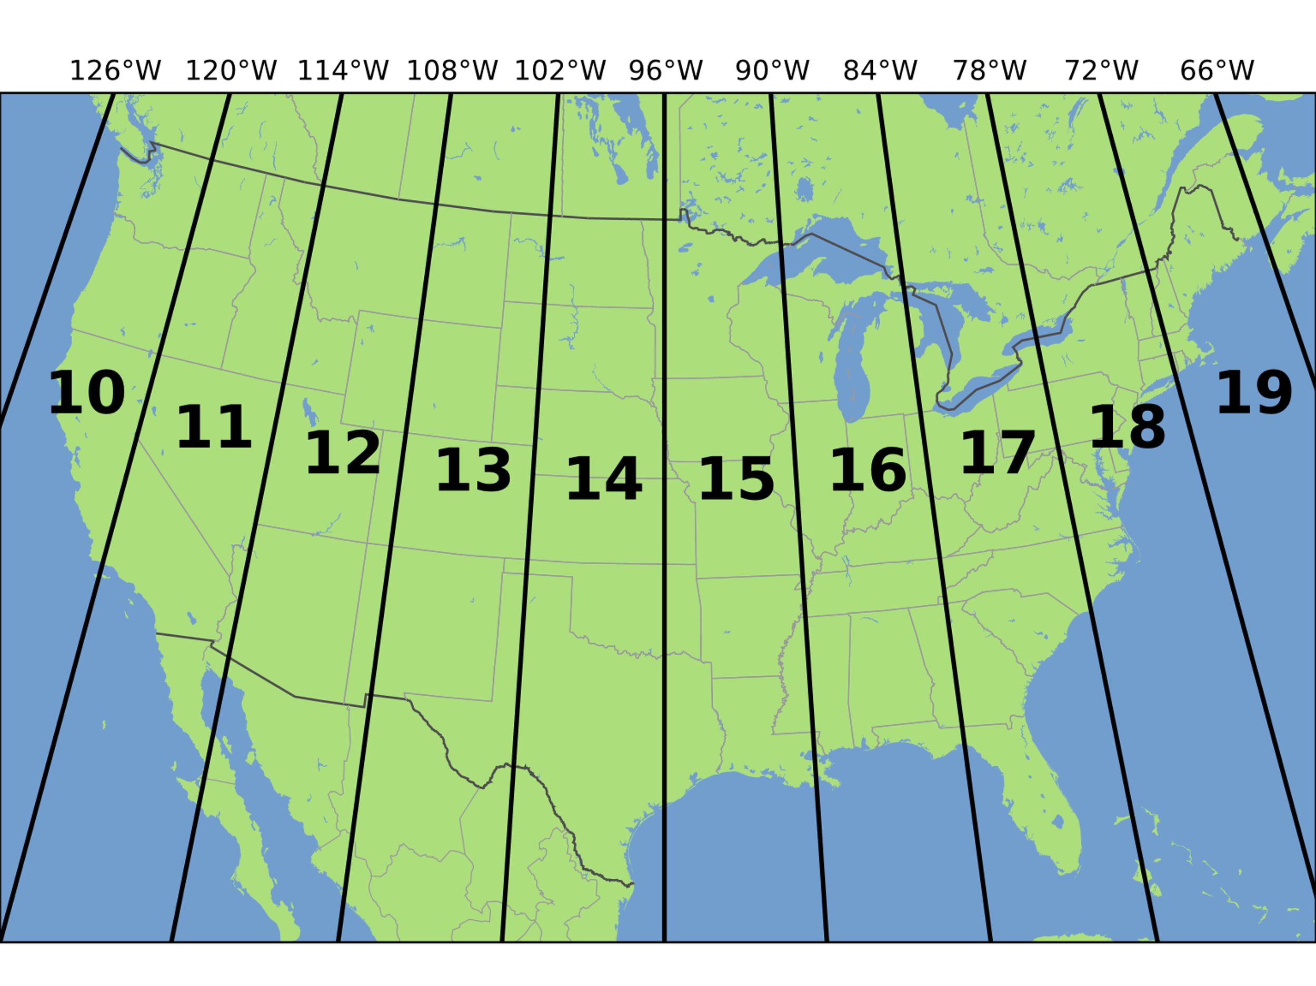
Coordinate reference system (CRS)
CRS is required to correctly position geospatial data on the Earth surface.
Geospatial data is incomplete if it misses a correct CRS information.
CRS contains:
Datum: Model of the earth shape. (e.g. WGS84)
Projection: Mathematical transformation from a round earth to a flat surface.
Additional parameters: required by the transformation formula.

Slide 9

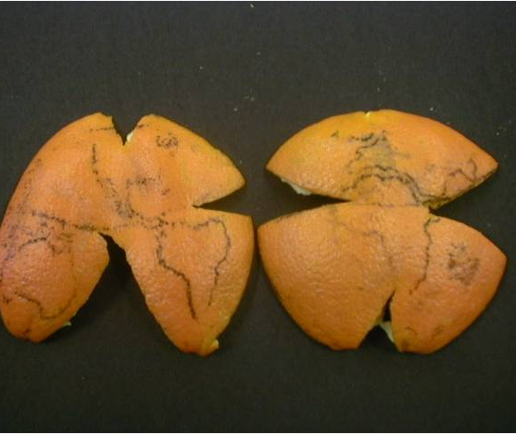
Coordinate reference system (CRS)
Datum: Is Earth an orange? Or a lemon?
Projection: How can I peel this orange/lemon?

Slide 10
Store and manipulate crs info
Systems for describing and sharing CRS info includes:
EPSG
Well-Known Text (WKT)
PROJ
Transforming data from one CRS to another can be achieved using various tools including GDAL.

Slide 11
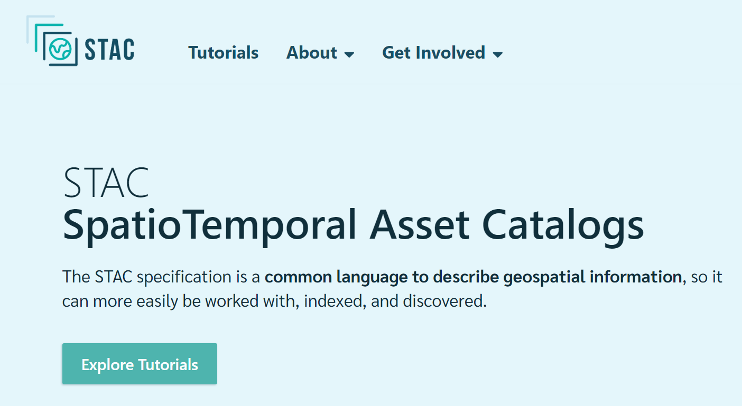
Satellite imagery access - stac
Searching: pystac-client
Manage catalog: pystac
Notes:
https://stacindex.org/catalogs/earth-search#/

Slide 12
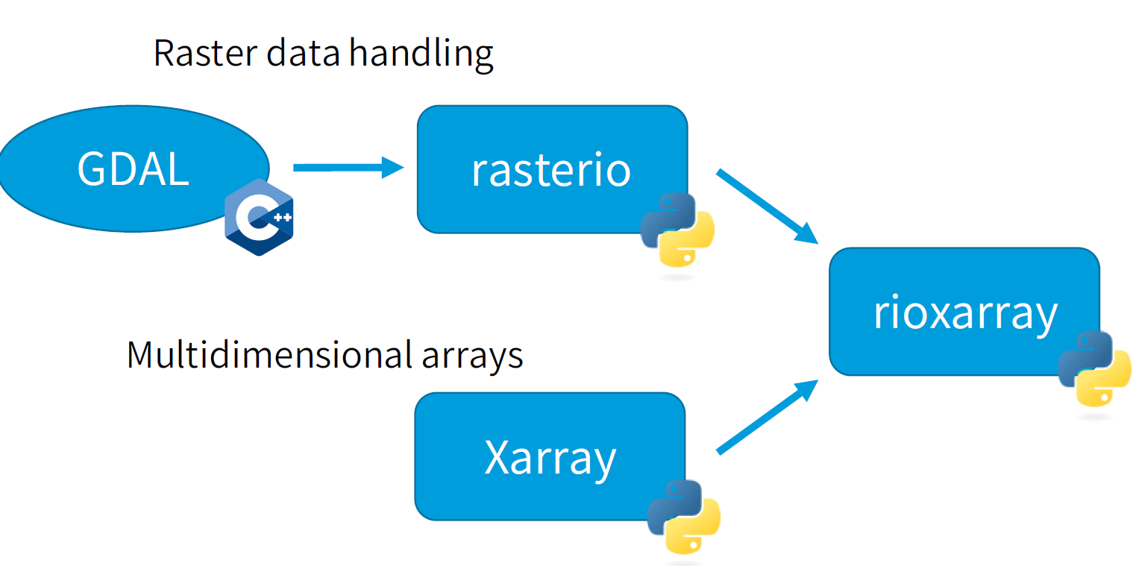
Raster data processing
Data loading
Raster calculation
Visualization

Slide 13
Jupyter Lab
Configure Jupyter lab start-up directory
Basic Shortcuts
Open Anaconda prompt and run:
jupyter notebook --generate-config
This writes a file to:
C:\Users\USERNAME\.jupyter\jupyter_lab_config.py
Open the file and search for the following:
#c.ServerApp.notebook_dir = ‘’
Uncomment and specify your working directory:
c.ServerApp.notebook_dir = '/the/path/to/working_dir/'
Shift + Enter : run the current cell, select below
Ctrl + Enter : run selected cells
Alt + Enter : run the current cell, insert below
Ctrl + S : save and checkpoint
A : insert cell above
B : insert cell below
Tab : autocomplete
Shift + Tab : view documentation or docstring
More….
Click on Help → Show Keyboard Shortcuts
Open Anaconda prompt and run:
jupyter notebook --notebook-dir= '/the/path/to/working_dir/’
jupyter lab --notebook-dir= '/the/path/to/working_dir/’

Slide 14
Overview
Questions
Where can I find open-access satellite data?
How do I search for satellite imagery with the STAC API?
How do I fetch remote raster datasets using Python?
Objectives
Search public STAC repositories of satellite imagery using Python.
Inspect search result’s metadata.
Download (a subset of) the assets available for a satellite scene.
Open satellite imagery as raster data

Slide 15
Accessing Metadata
The SpatioTemporal Asset Catalog (STAC) specification
Exercise 1: Inspect a STAC catalog (3mins)
API BASE URL
https://earth-search.aws.element84.com/v1
Cloud Optimized GeoTIFFs (COGs)
Regular geotiffs with additional features that make them ideal to be employed in the context of cloud computing and other web-based services.
from pystac_client import Client
client = Client.open(api_url)
Using intersecting a point
from shapely.geometry import Point
point = Point(4.89, 52.37)
search = client.search( collections=[collection], intersects=point,
max_items=10)
Search by a polygon or a buffer distance
Exercise 2: Custom filter to search satellite scenes (10mins)
Buffer of 0.01 degree, Jan 10 to Feb 10, cloud cover < 10%
bbox = point.buffer(0.01).bounds
search = client.search(
collections=[collection],
bbox=bbox,
datetime="2020-03-20/2020-03-30",
query=["eo:cloud_cover<15"]
)

Slide 16
Accessing data
Accessible via the assets in the items
assets = items[0].assets
print(assets.keys())
Print the description of the assets
for key, asset in assets.items():
print(f"{key}: {asset.title}")
Retrieve the thumbnail
print(assets["thumbnail"].href)
Read data from URL
import rioxarray
nir_href = assets["nir"].href
nir = rioxarray.open_rasterio(nir_href)
print(nir)
Save the data to disk
nir.rio.to_raster("nir.tif")
Saving subset of the data
nir[0,1500:2200,1500:2200].rio.to_raster("nir_subset.tif")
Exercise 3: Retrieve assets for Landsat 8 (10mins)

Slide 17
Reading data
Load from a search result
import pystac
items = pystac.ItemCollection.from_file("search.json")
Print(items)
Open the asset from URL
import rioxarray
raster_ams_b9 = rioxarray.open_rasterio(items[0].assets["nir09"].href)
raster_ams_b9
Printing metadata information
print(raster_ams_b9.rio.crs)
print(raster_ams_b9.rio.nodata)
print(raster_ams_b9.rio.bounds())
print(raster_ams_b9.rio.width)
print(raster_ams_b9.rio.height)
Visualize raster data
raster_ams_b9.values
raster_ams_b9.plot()
Improve color contrast
raster_ams_b9.plot(robust=True)
robust=True, displays values between the 2nd and 98th percentile
Color range
raster_ams_b9.plot(vmin=100, vmax=7000)

Slide 18
View crs Info
Print the crs string
print(raster_ams_b9.rio.crs)
Print the EPSG code
raster_ams_b9.rio.crs.to_epsg()
Mode details of CRS
from pyproj import CRS
epsg = raster_ams_b9.rio.crs.to_epsg()
crs = CRS(epsg)
Exercise 4: Find the axes units of the CRS (3mins)
CRS Info
print(crs.name)
print(crs.area_of_use)
print(crs.axis_info)
print(crs.coordinate_operation)
print(crs.datum)

Slide 19
Raster statistics
View summary statistics
print(raster_ams_b9.min())
print(raster_ams_b9.max())
print(raster_ams_b9.mean())
print(raster_ams_b9.std())
print(raster_ams_b9.quantile([0.25, 0.75]))
Using numpy to get raster statistics
import numpy
print(numpy.percentile(raster_ams_b9, 25))
print(numpy.percentile(raster_ams_b9, 75))

Slide 20
No data value
Print the no data value
raster_ams_b9.rio.nodata
Distinguish missing data by converting it to indefinite number e,g np.nan
Using rioaxarray, set masked=True
raster_ams_b9 = rioxarray.open_rasterio(items[0].assets["nir09"].href, masked=True)
Or use where function
raster_ams_b9.where(raster_ams_b9!=raster_ams_b9.rio.nodata)
Printing summary statistics again
print(raster_ams_b9.min())
print(raster_ams_b9.max())
print(raster_ams_b9.mean())
print(raster_ams_b9.std())
Plot again
raster_ams_b9.plot()

Slide 21
Multiple band
Get description of the assets
for key, asset in assets.items():
print(f"{key}: {asset.title}")
Select the multiband asset from assets
raster_ams_overview = rioxarray.open_rasterio(items[0].assets['visual'].href, overview_level=3)
print(raster_ams_overview)
Examine the shape
raster_ams_overview.shape
Visualize
raster_ams_overview.plot.imshow()
What is wrong with the image? It is stretched. Set the aspect ratio
Exercise 5: Set the Plotting aspect ratio.
Answer:
raster_ams_overview.plot.imshow(size=5, aspect=1)

Slide 22
Training Workshop
Introduction to Geospatial Raster and Vector Data with Python
12-13 March ITC Building, Room 2301

Slide 23


Centre of Expertise in Big Geodata Science Training Workshop
Publishing Spatiotemporal Data with STAC
Join us to learn how to discover and use data available in public STAC catalogs, and how to create your own data catalogs with STAC:
Fundamentals of STAC
Discovery of spatiotemporal data with STAC
Retrieving and processing of data available in STAC catalogs
Publishing spatiotemporal data with STAC
Registration
2 April, 9:00 – 16:00 ITC Building, Room LA 2105

